Slide 1
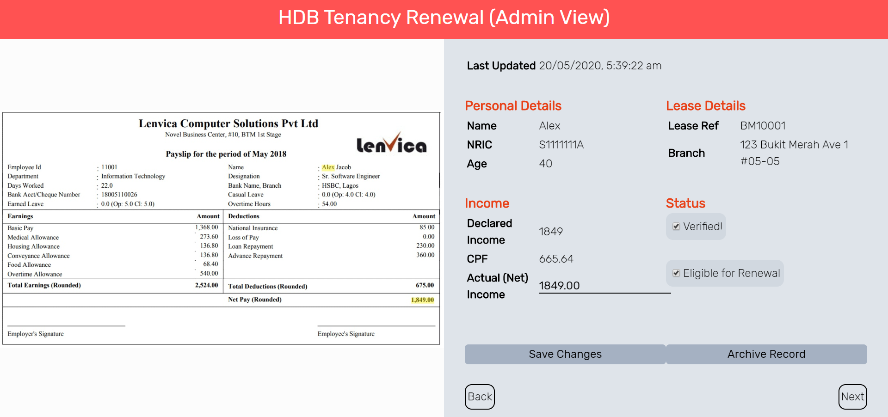
HDB Tenancy Renewal App
Prototype demo for COVID-19 Idea Sprint

Slide 2
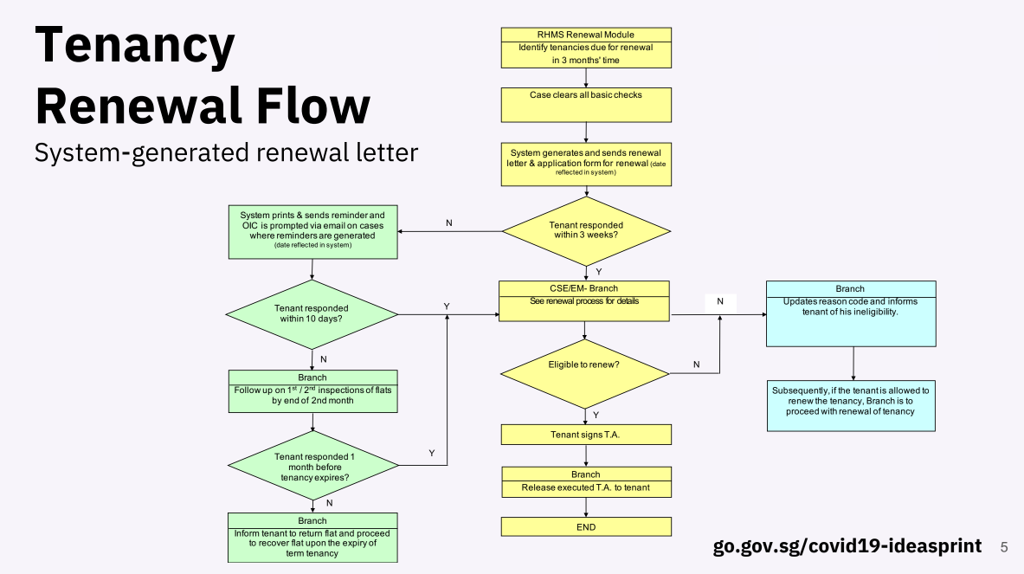
Targets pain points experienced during renewal by digitizing process

Slide 3
Problem Statement
How might we design a digital process for tenancy renewal?
Previous process involved face-to-face meetings with branch managers
Required wet ink signature on income declaration
Specific issues to consider:
How to verify identity?
How to verify income?
Taking note that a number of tenants may not have CPF contributions
Accountability
How can we ensure the process remains as valid as with manual verification?

Slide 4
Proposed Solution
(1) Identity Verification via Singpass
(2) Submission of Income Documents on HDB App
(3) System Verification of Documents + Renewal Eligibility
Information Required:
Name
Age (for CPF Calculation)
Lease Reference
Address
Requirements:
Name clearly shown
Income clearly shown
Document verification via Open Character Recognition (OCR) + backend logic
Added accountability by allowing additional manual validation
Integrated into HDB App
Prototype Shown

Slide 5
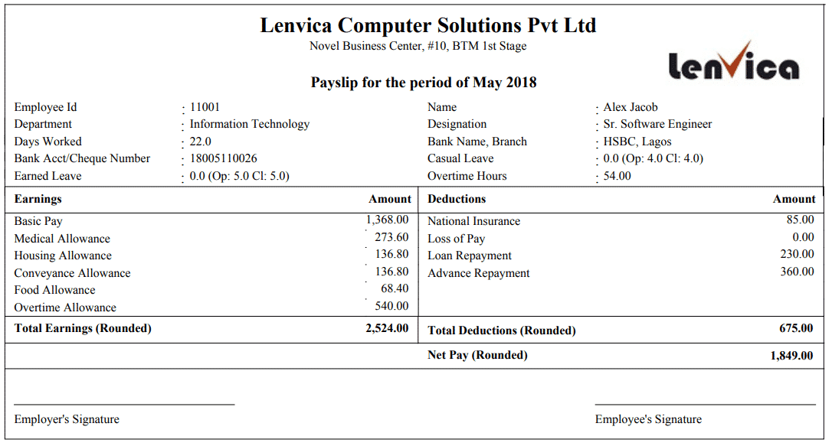


System Verification
OCR
“…Lenvica Solutions Pvt Ltd… Payslip for the period…”
Text extracted from image
✓
Payslip Image
X
Income Found?
(system searches for ‘income’ and numbers following it)
Upload unsuccessful,
please submit clearer image
✓
This information is fed into…
X
Name Found?
(system searches for name sent via Singpass)
Documents Not Verified
✓
X
Is detected income = declared income?
Database of Payslips
✓
✓
X
Is CPF Information Available?
Is expected CPF within range of actual CPF?
(Expected CPF = declared income * CPF rates)
✓
X
Documents Verified!
Administrator View
Is income below threshold?
X
✓
Ineligible for Renewal
Eligible for Renewal

Slide 6
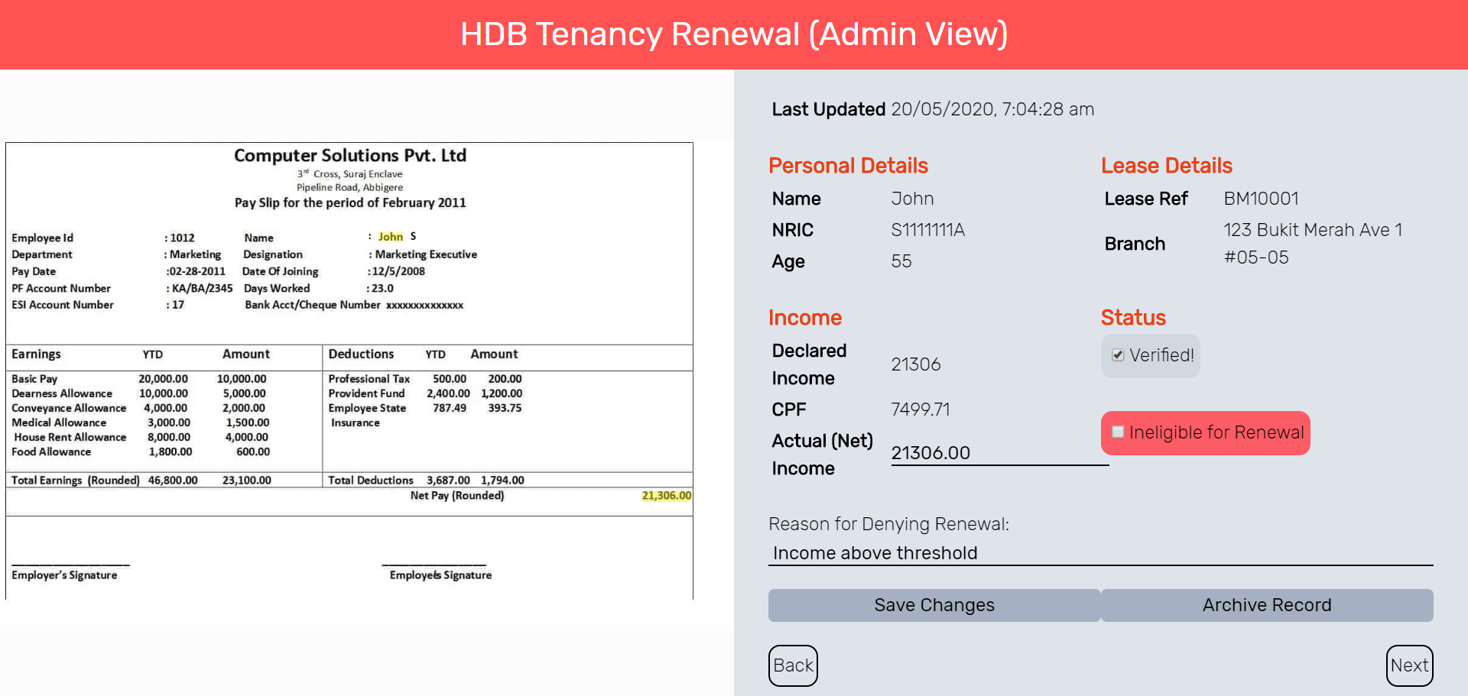
Information from Singpass

Slide 7
Original Payslip Annotated with System-Detected Fields
Detected by System

Slide 8
Purpose of Admin View
System has already logged record as ‘verified’ and ‘ineligible’
Set a processing period (e.g. 1 week)
afterwards, record is archived and system’s decisions are considered correct → auto-generate TC for tenant
Within that period, OPTIONALLY, branch managers can look through and override
Even if all records are manually validated once more, the process is still sped up due to less manual entry
Necessity of this depends on accuracy of OCR and backend logic
OCR using open-source Google Tesseract (which this prototype uses) is widely considered to be accurate

Slide 9
Prototype Demonstration
Cases demonstrated:
Everything Accurate
Fake Income Slip
Income over threshold
Blurry income slip
* Notes:
Income threshold is set to $3000 due to availability of sample payslips
CPF calculation is only estimated

Slide 10
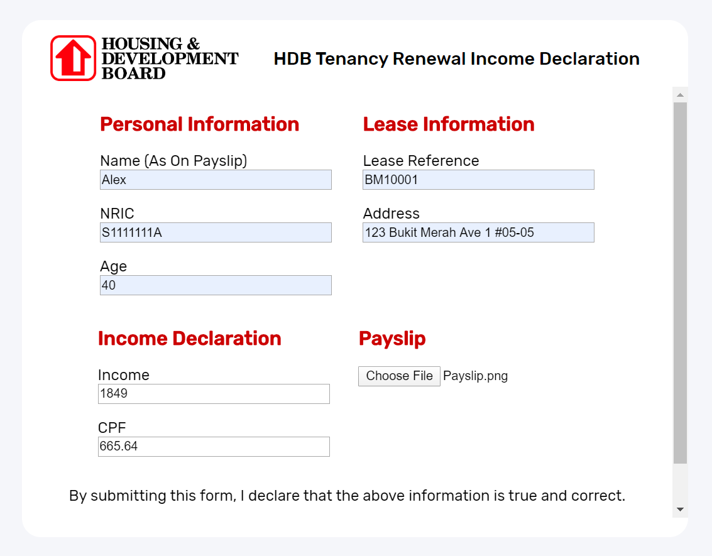
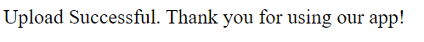
Case 1: Everything Accurate

Slide 11
Case 1: Everything Accurate
System able to detect name, income and accurately determine verification and renewal
(threshold set at $3000 instead of $1500 for demo)

Slide 12
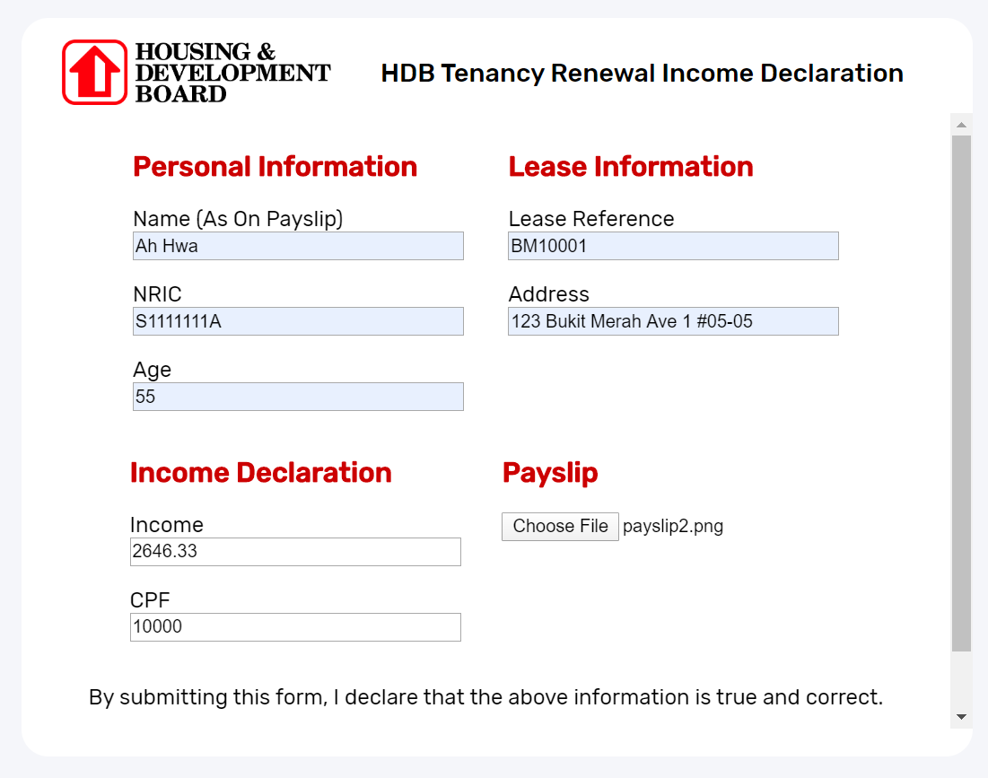
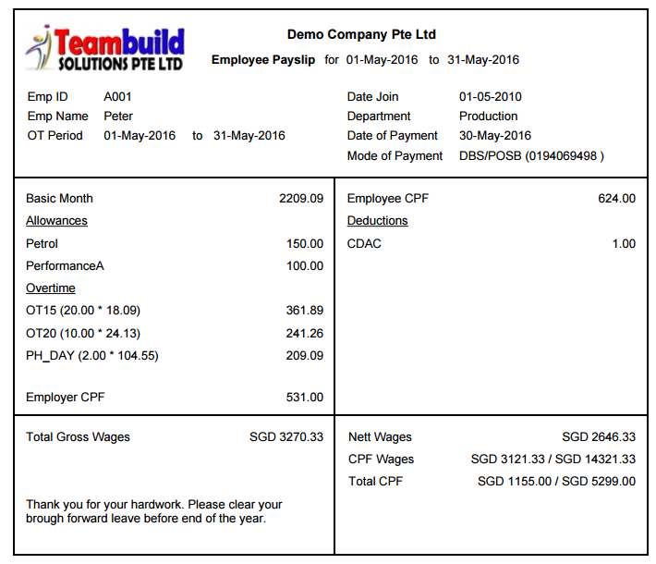
Case 2: False Income Slip

Slide 13
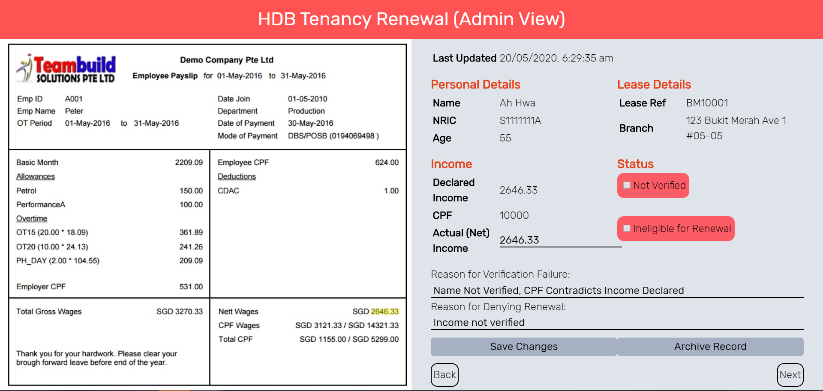
Case 2: False Income Slip
System able to detect that the income slip does not belong to the tenant based on name + CPF indicates this too
Benefit of Admin View: allow manual override, e.g. if income slip is English, unofficial name

Slide 14
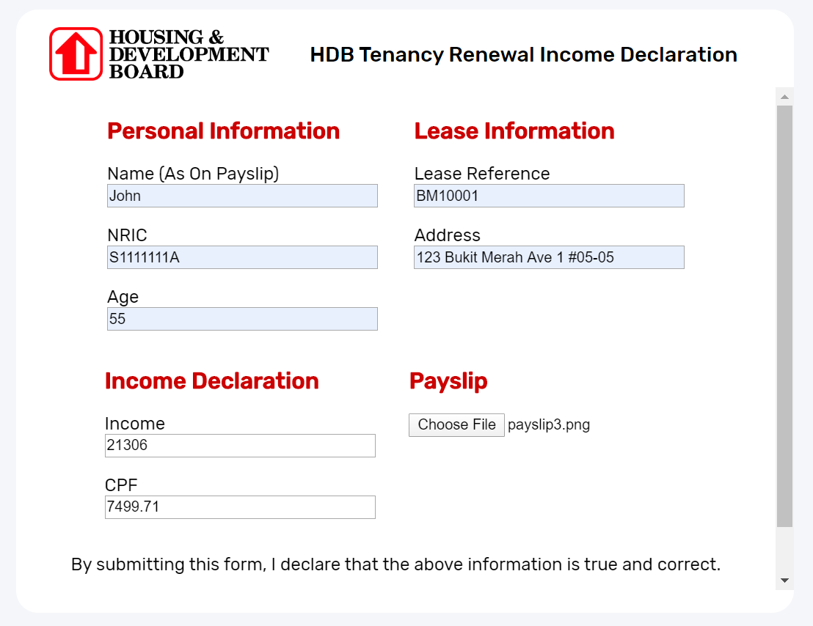
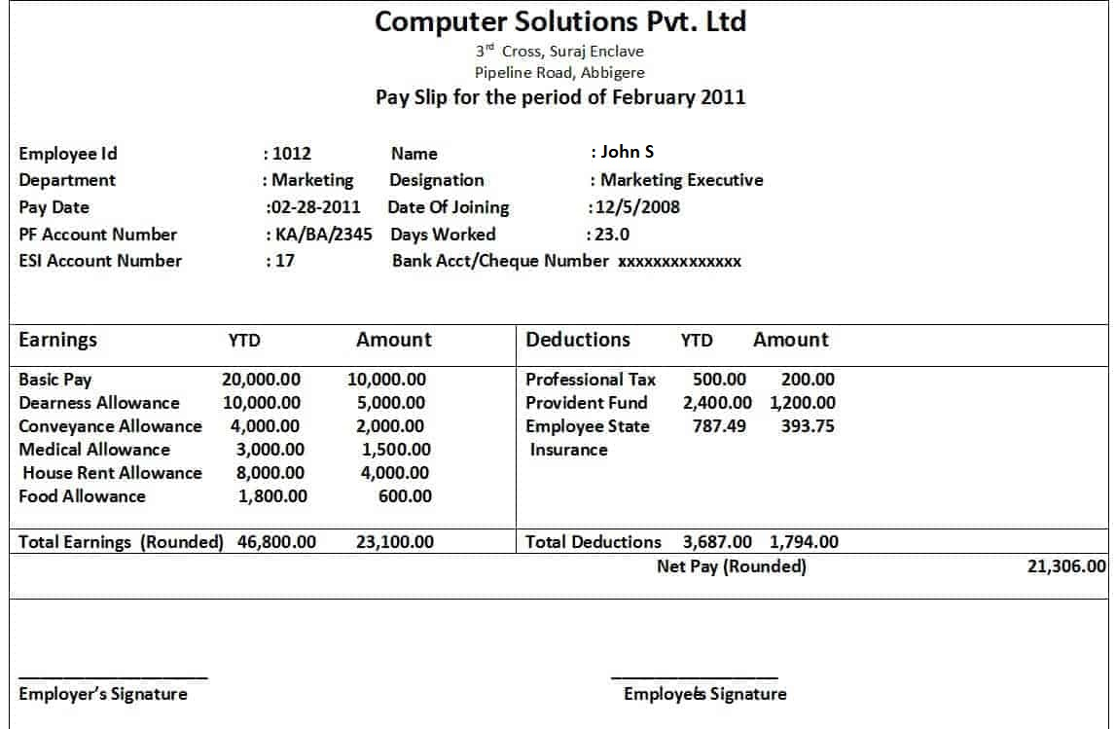
Case 3: Income over Renewal Threshold

Slide 15
Case 3: Income over Renewal Threshold
System verified income slip and determined ineligibility

Slide 16
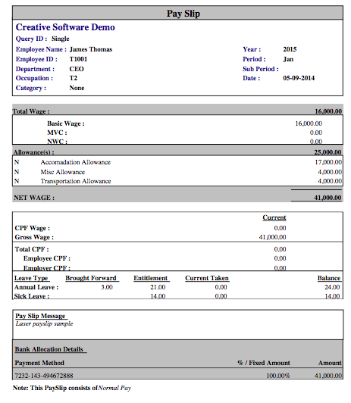
Case 4: Unclear Image

Slide 17

User Interface Demonstration

